Slide 1
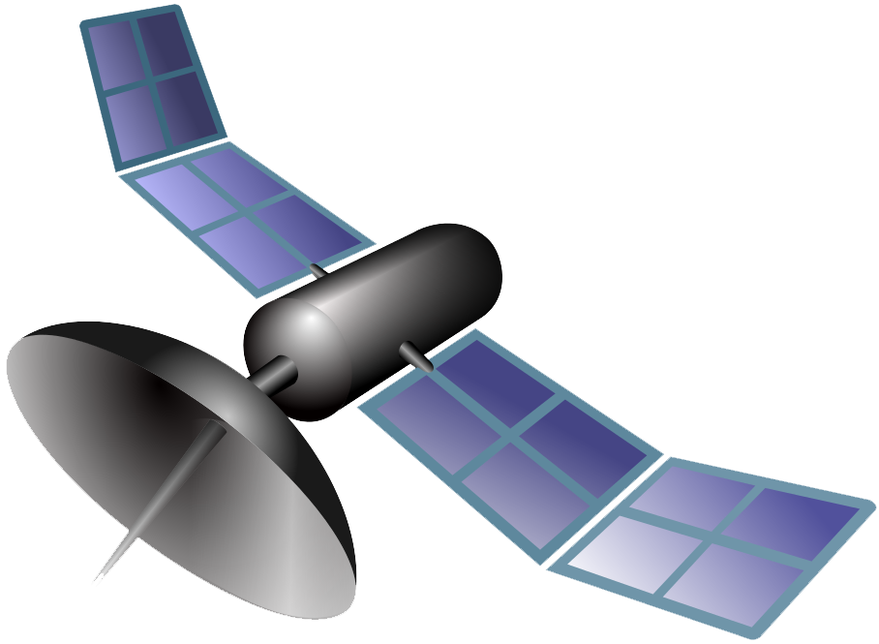
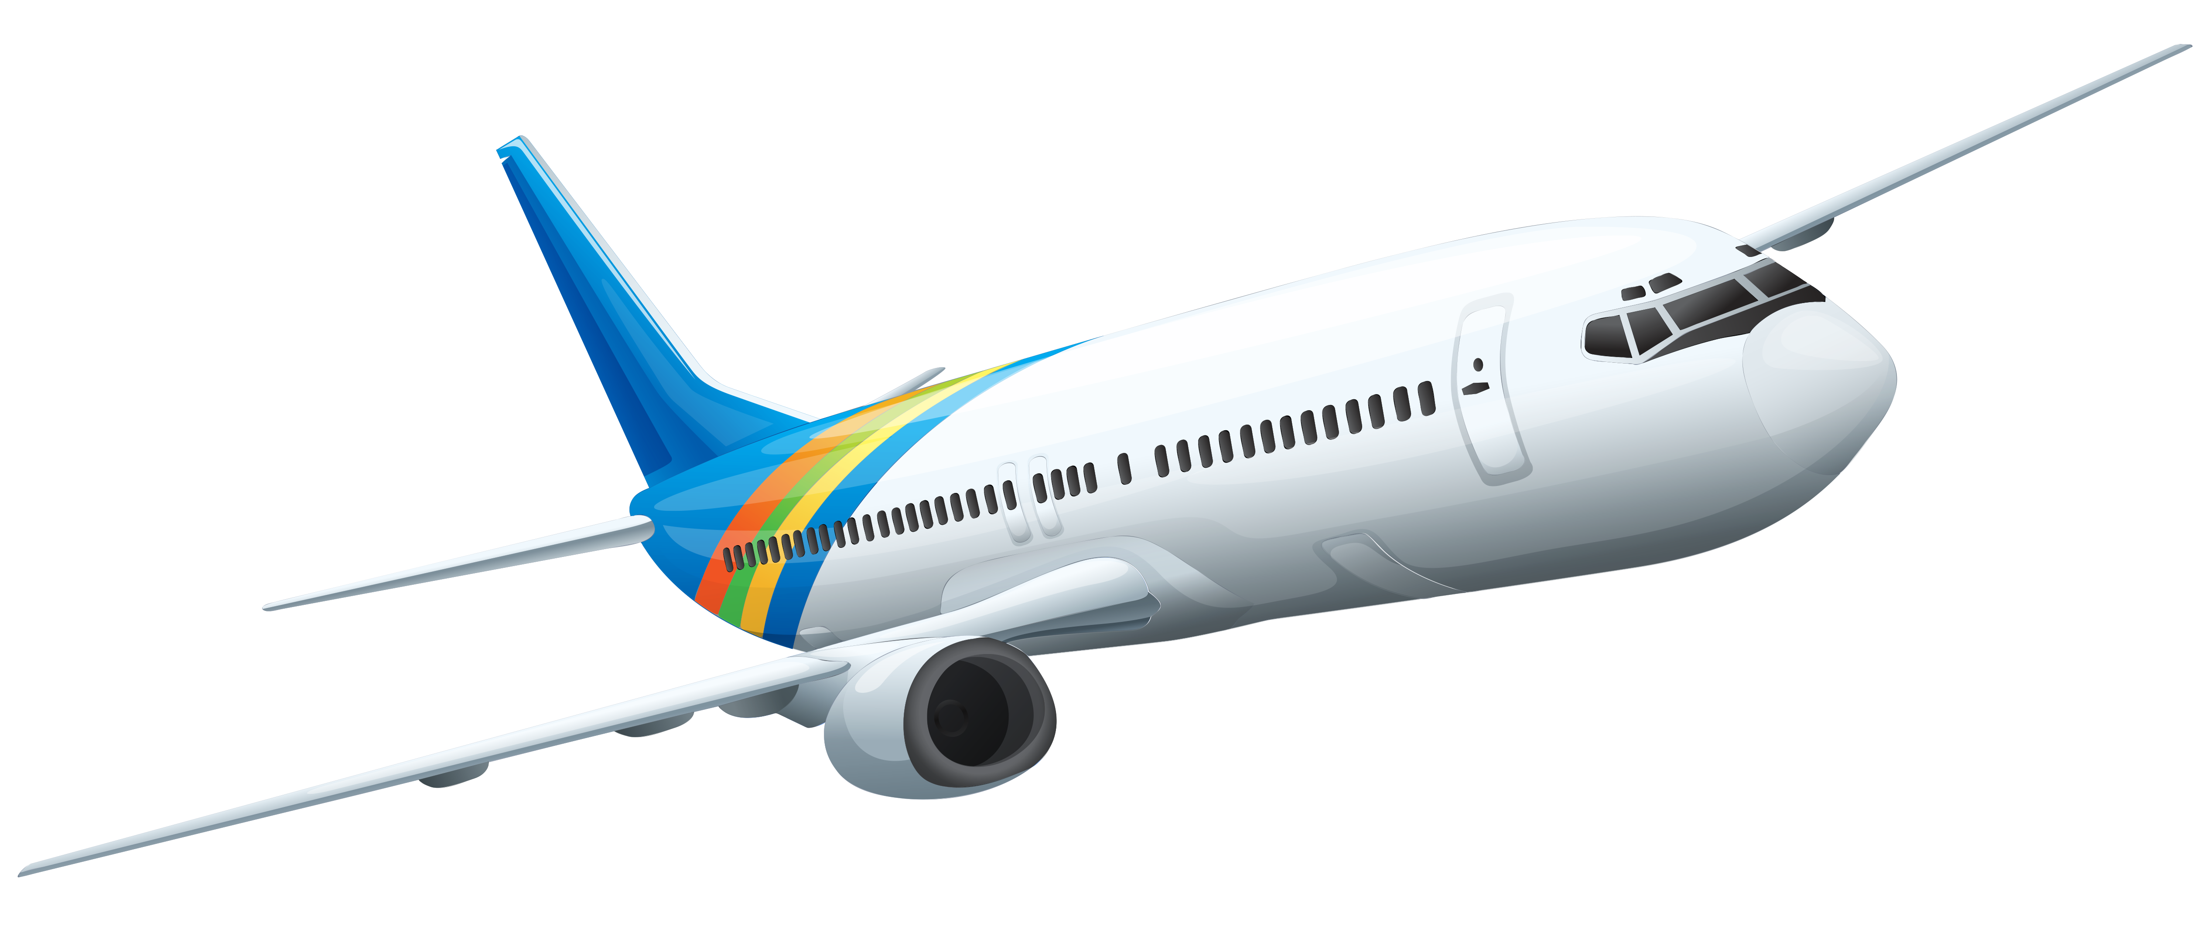
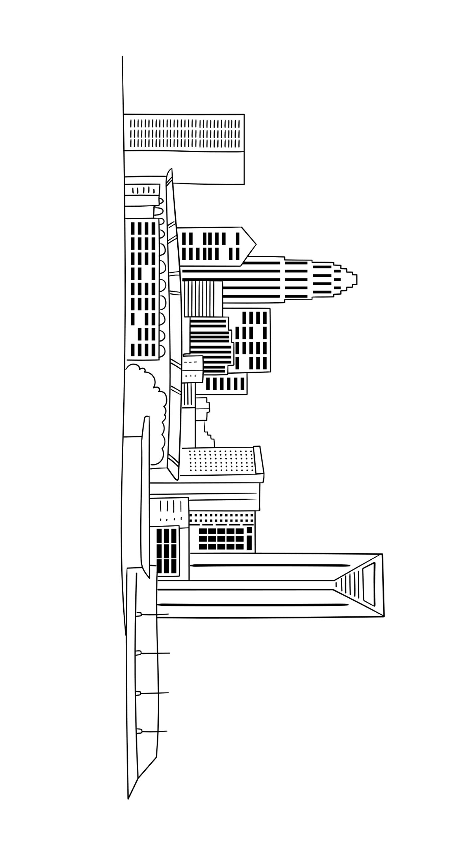
TROPOSPHERE!
STRATOSPHERE!
MESOSPHERE!
THERMOSPHERE!
EXOSPHERE!
Chessay.com

